Slide 1
World War I-The Great War
Causes

Slide 2
Ultimate Causes of the Great War
Militarism
Alliance Systems
Imperialism
Nationalism

Slide 3
Militarism =glorification of armed strength and the ideals of war
Large standing armies
British Navy “two=power rule”
Modernization of weapons and ships

Slide 4
Arms Race

Slide 5
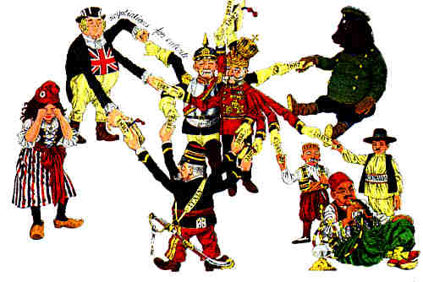

Slide 6
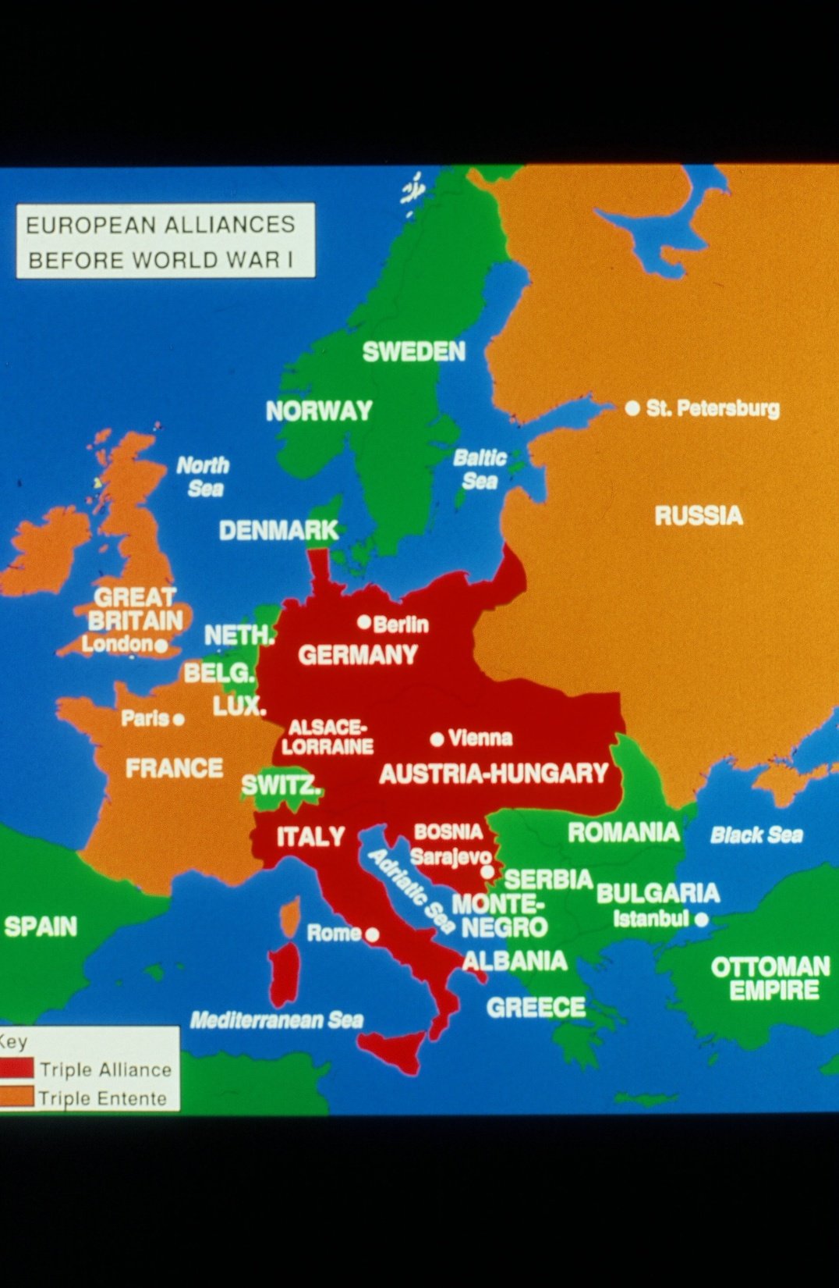
Entangling Alliances-
No country felt strong enough on their own
Triple Entente
Triple Alliance

Slide 7
Imperializing

Slide 8
Size of Colonial Empires in 1913
 | Area (square kilometers) | Population of Colonies
Britain | 33,000,000 | 400,000,000
France | 11,500,000 | 56,000,000
Germany | 2,950,000 | 12,000,000
Belgium | 2,400,000 | 15,500,000
Portugal | 2,100,000 | 7,000,000
Holland | 2,000,000 | 38,000,000
Italy | 1,500,000 | 1,600,000
USA | 324,000 | 10,000,000
Japan | 300,000 | 17,000,000
Spain | 250,000 | 700,000
Austria-Hungary | 0 | 0
Russia | 0 | 0

Slide 10
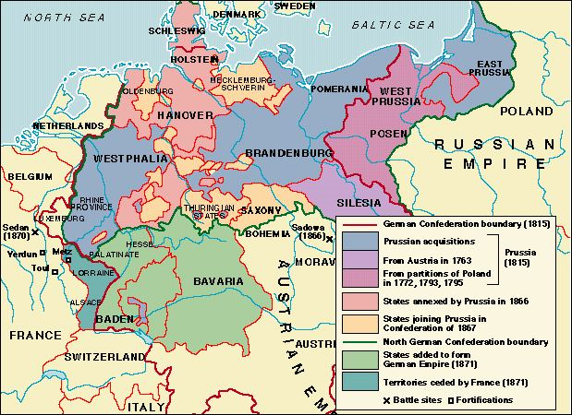
Nationalism
Nationalism- devotion to the interests of one’s nation
Extreme patriotism
Aspirations of independence for nationalities under control of others like Austria-Hungary

Slide 11
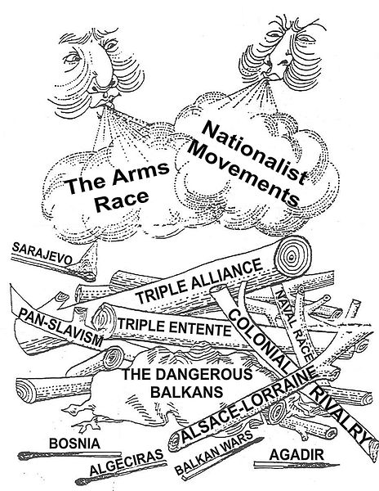

Slide 12
The Proximate Cause–Assassination in the Balkans

Slide 13
The Balkans
Formerly ruled by the Ottoman Empire
Mountainous with different ethnic groups. Mostly Slavic with ethnic ties to Russians.
Austria-Hungary had annexed most of the territory although there had been several revolts and border wars.
Bosnia was annexed by Austria in 1908- Serbia resented this and desired to make them united into one Slavic nation.

Slide 14
Archduke Franz Ferdinand
June 28, 1914- the heir to the Austrian throne visits the Bosnian capital of Sarajevo
Coincidence? June 28 = anniversary of defeat at the hands of the Ottomans in 1389
Archduke plans a grand parade in honor of his wife Sophie to celebrate their anniversary

Slide 15
Black Hand---Union or Death
Secret Serbian nationalist society
Plans assassination of Archduke
After multiple attempts, Gavrilo Princip successfully assassinates the Archduke and his wife
Assassin is arrested

Slide 16
Ultimatum
Austria demands Serbia suppress all anti-Austrian activity, dismiss all Serbian officials Austria requests, and allow Austria access to investigate all anti-Austrian activity= give up sovereignty
Germany had given Austria a blank check of support and Serbia had Russia’s full support
Serbia refuses which triggers alliances

Slide 17
The Dominoes Fall
July 28: Austria- Hungary declares war on Serbia
July 30: Russia mobilizes troops
August 1: Germany declares war on Russia
August 3: Germany declares war on France for honoring Entente
August 3: Germany invades neutral Belgium to get to France – Schleiffen Plan
August 4: Britain declares war on Germany
The sides are set Central Powers v. Allies

