Slide 1
Age of Exploration

Slide 2
Spurs to Age of Exploration
1. Renaissance
Focus on individual accomplishment
Encouraged questioning and discovery
Exposure to classical texts concerning world geography
Notes:
Sphaera Mundi [with other tracts]: Sphaera cum Theorcis Disputationibus Johannis Regiomontani contra Cremonensium Deliramenta Theoricas Source: Johannes de Sacrobosco, Regiomontanus, Georg von Peuerbach. Sphaera Mundi (17.45) | Heilbrunn Timeline of Art History | The Metropolitan Museum of Art

Slide 3
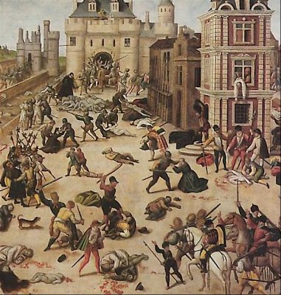
Spurs to Age of Exploration
2. Reformation
Religious wars
Rivalry between Catholic and Protestant countries
Inspired migration to escape religious persecution or be missionaries
Notes:
St Bartholomew’s Day Massacre --In France, the protestants were known as Huguenots. But in August and September of 1572 Catholics in Paris began murdering Huguenots in their thousands. Painting by François Dubois, a Huguenot painter born circa 1529 in Amiens, who settled in Switzerland. Although Dubois did not witness the massacre, he depicts Admiral Coligny's body hanging out of a window at the rear to the right. To the left rear, Catherine de' Medici is shown emerging from the Louvre to inspect a heap of bodies.

Slide 4
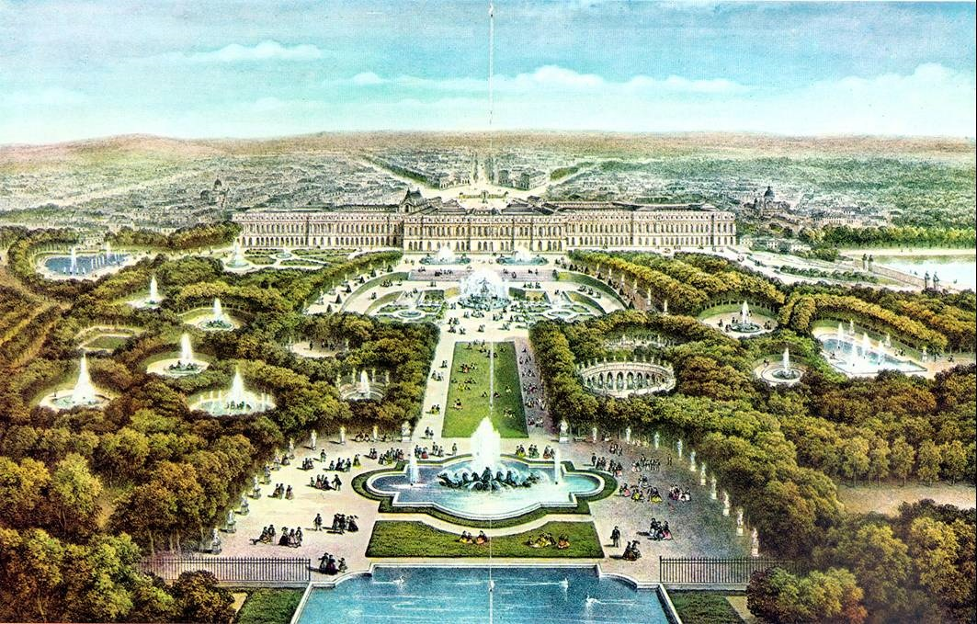
Spurs to Age of Exploration
3. Strong Central Governments
Consolidate power created stability
Increasing wealth enabled them to look outside their borders

Slide 5
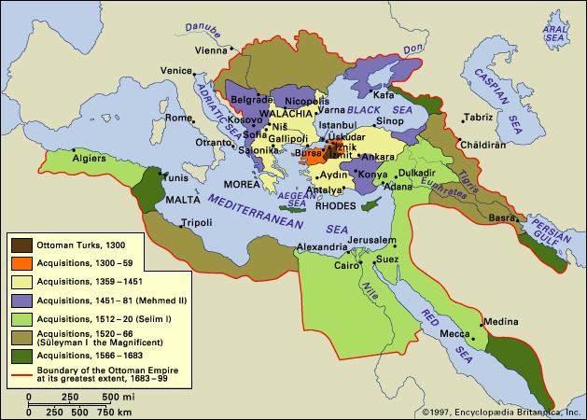
Spurs to Age of Exploration
4. Spread of Islam
Fall of Constantinople limited access to the overland route to the East
New routes needed to be found to avoid the Ottomans

Slide 6
Spurs to Age of Exploration
5. Crusades
Created European demand for eastern goods
Encouraged appetite for conquest and adventure
Inspired religious zeal
Spurred trade
Exposure to new technology and innovations

Slide 7
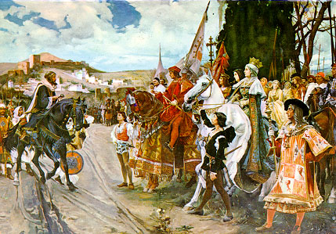
Spurs to Age of Exploration
6. Reconquista of Spain
Unification of Spain
Christianization of Spain encouraged further extension
Desire to establish dominance over Islam

Slide 8
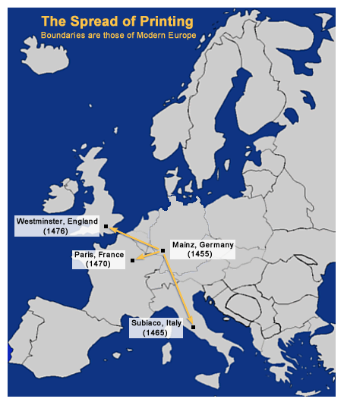
Spurs to Age of Exploration
7. Printing Press
Increasing access to old and new information for many

Slide 9
The Players
Netherlands
Nonresident Monarchy with strong local government
Protestant
England
Parliamentary Monarchy
Anglican
Portugal
Absolute Monarchy
Catholic
France
Absolute Monarchy
Catholic
Italy
City-states
Catholic
Spain
Absolute Monarchy
Catholic
Notes:
Where are they? What was the order?

Slide 10
Explorers
“New islands, new lands, new peoples: and what is more, a new sky and new stars.”
-Pedro Nunes, 1537
Portugal
Bartholomeu Dias
Vasco de Gama
Ferdinand Magellan
Spain
Christopher Colombus-1492
Amerigo Vespucci-1499

Slide 11
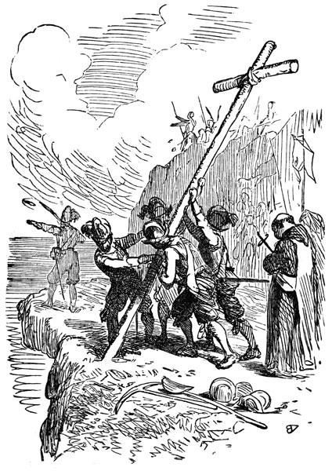
Motivations
“To bring to light those in darkness, and also to get rich.”
-Bernal Diaz del Castillo
Political/Power
Establish Power Base
Check Rivals Power
Economic
Land
Trade Routes
Resources
Religious
Spread It
Practice It Freely
Exploratory
Fame, Fortune, & Adventure

Slide 12
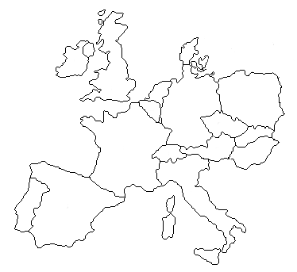
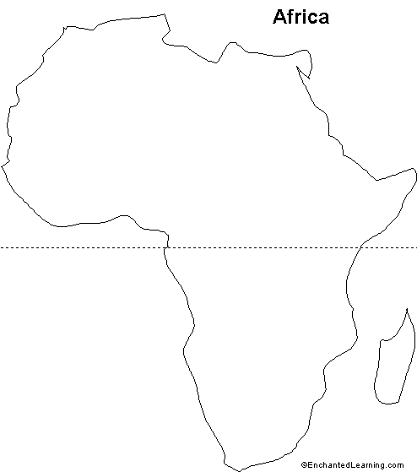
Colombian Exchange
Horse
Cow
Pigs
Chickens
Turkey
Goat
Sheep
Guns
Metal Tools
Precious Metal Craft
Wheel
Potato
Tomato
Banana
Coffee
Lettuce
Corn
Sugar
Tobacco
Wheat
Cocoa
What else came with the exchange?
What do you think is meant by Triangle Trade?
Notes:
Disease, slaves, religion

Slide 13
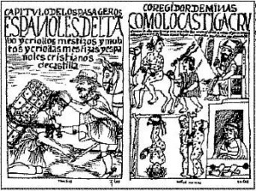
Labor in the New World
Encomienda
granted a person a specified number of natives for whom they were to take responsibility
Encomendero was to protect the natives and to instruct them in the Spanish language and Catholic faith.
In return, they could exact tribute from the natives in the form of labor, gold or other products, such as in corn, wheat or chickens

Slide 14
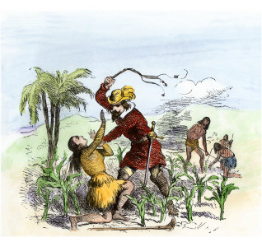
Problems with Encomiendas
Mixed Race could not be included
Population of natives declined
Protests over abuses
Need for a new labor supply
Needs of plantation system

Slide 15
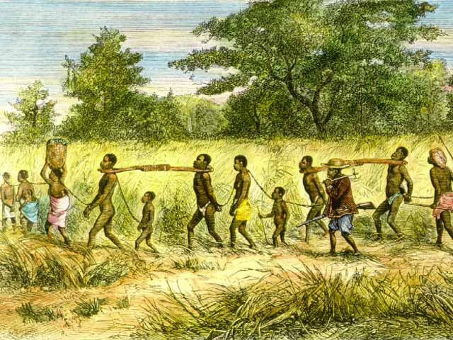
Acquisition of Slaves

Slide 16
African Slave market
1. Negroes displayed for sale in a public market. 2. A Negro Slave being examined before being purchased. 3. An Englishman licking the Negro's chin to confirm his age, and to discover from the taste of his sweat that he is not sick. 4. Negro Slave wearing the mark of slavery on his arm.
5. Ship at anchor waiting for the completion of the Slave Trade. 6. Launch carrying purchased slaves to the Slave Ship. 7. Negroes on the shore who are wailing and shrieking on viewing their relatives or friends being taken away.

Slide 17
Slave Factories

Slide 18
Middle Passage

Slide 19
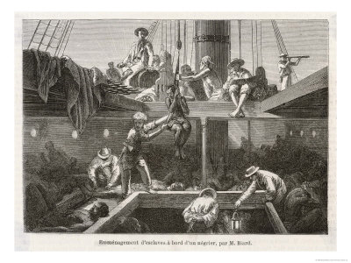

Slide 21
Resistance

Slide 22
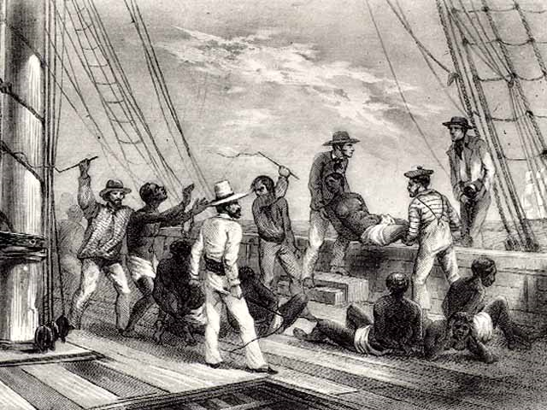

Slide 23
The Colonial Class System
Peninsulares
What is
the basis
for this
system?
Creoles
Mestizos
Mulattos
Native Indians
Black Slaves

